Slide 1

The Blueprint | Repair & Restore
Summer 2023

Slide 2
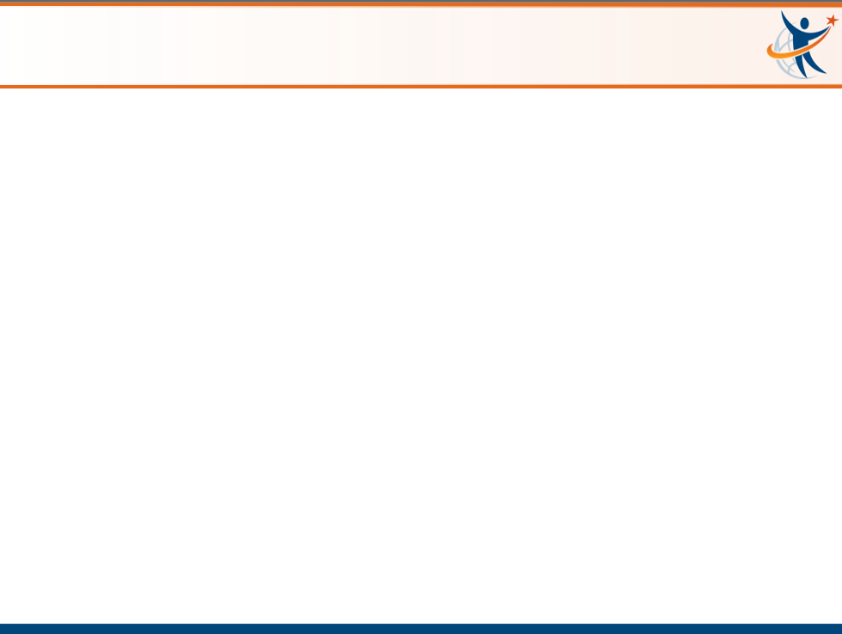
Intended Outcomes
By end of this session,
You will gain an understanding of:
  The purpose and elements of the RULER Blueprint
  The connections between the Blueprint and the Problem Solving STEPS of Second Step
  How to use the Blueprint with a student and/or within an academic content lesson
You will be better equipped to:
  Contribute to an environment that will help students and those around you….

Slide 3
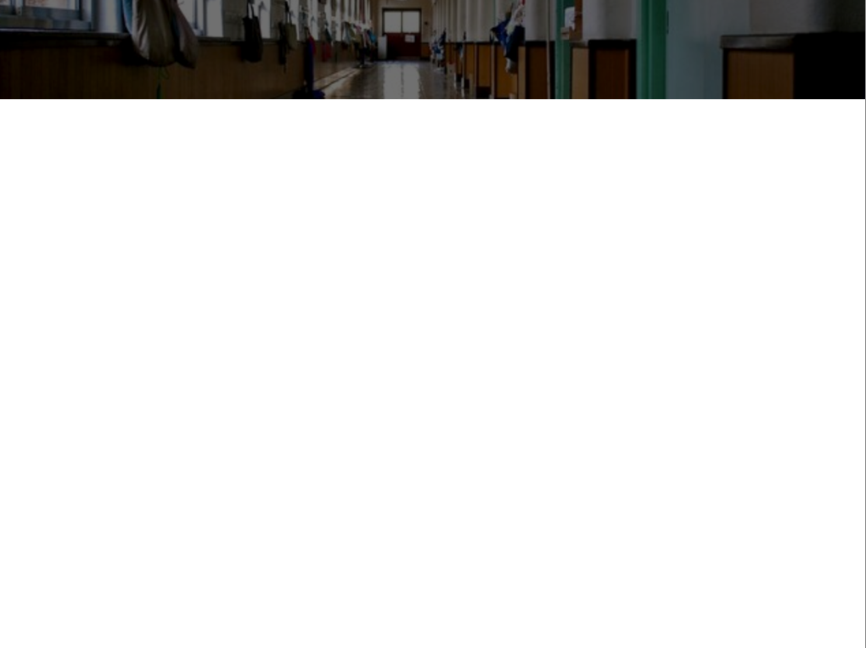
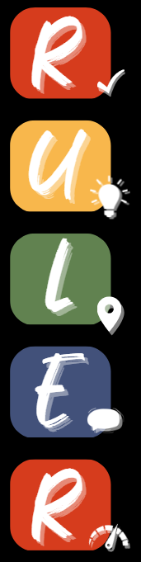
Let’s Review: The RULER Skills
Recognizing emotions in ourselves and others
Understanding the causes and consequences of emotions
Labeling emotions accurately
Expressing emotions appropriately
Regulating emotions effectively

Slide 4


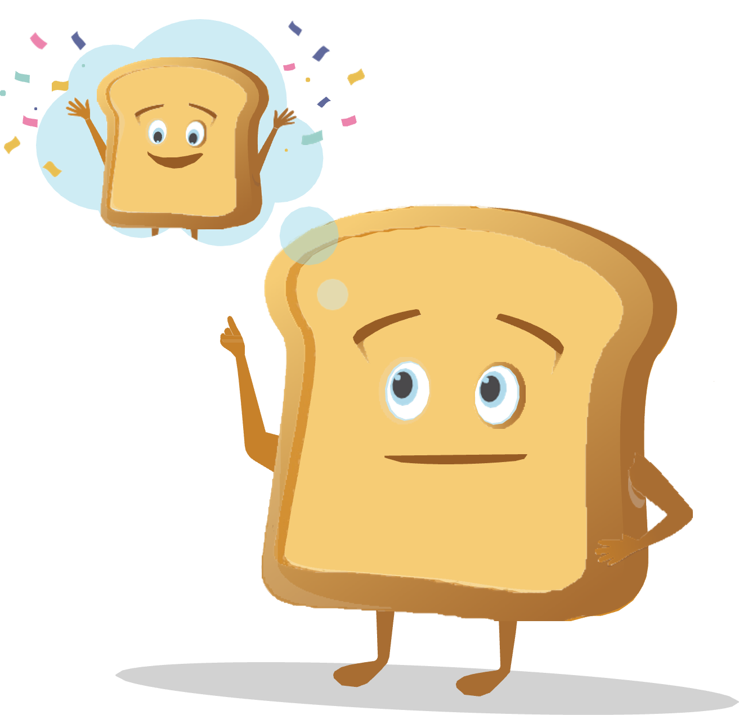
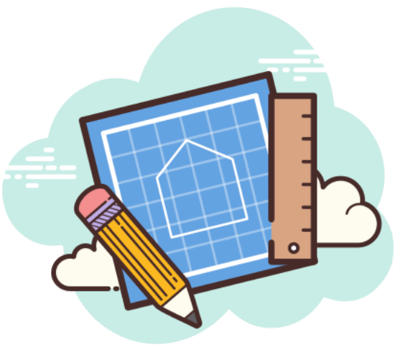
THE RULER ANCHOR TOOLS
The Charter represents agreed-upon norms for how everyone in a school, classroom, or other environment wants to feel. The Charter also explains what needs to happen or change to build and sustain positive emotional climates.
The Mood Meter is a visual guide to help individuals accurately analyze and “plot” their feelings. The Mood Meter develops skills in recognizing and labeling emotions, which can be further developed into understanding, expressing, and regulating emotions.
The Meta-Moment is a process for responding to emotional triggers in ways that align with one’s best self. The goal is to shift from automatic, unhelpful reactions to strategic, effective responses.
The Blueprint is a problem-solving tool for working with interpersonal conflicts. The Blueprint can be used independently or collaboratively to enhance empathy and identify effective solutions for past, real-time, or anticipated conflicts.

Slide 5

THE BLUEPRINT
We can tap into the restorative potential of conflict by using the fourth RULER tool: the Blueprint.
The Blueprint as a tool for reflecting on conflict and guiding conferences to resolve conflict and help to restore communities
Through answering questions about the conflict, we learn to empathize and consider the situation from the other person’s perspective.
The benefits of empathy and strategies for cultivating empathy, including active listening and paraphrasing

Slide 6
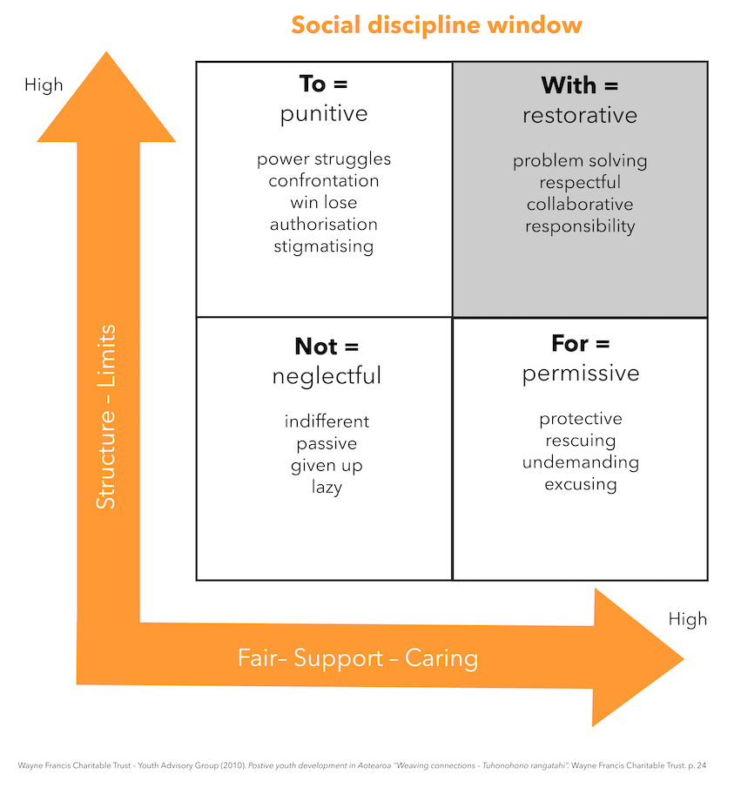
Restorative Practices
Notes:
Crucial conversations about feedback

Slide 7
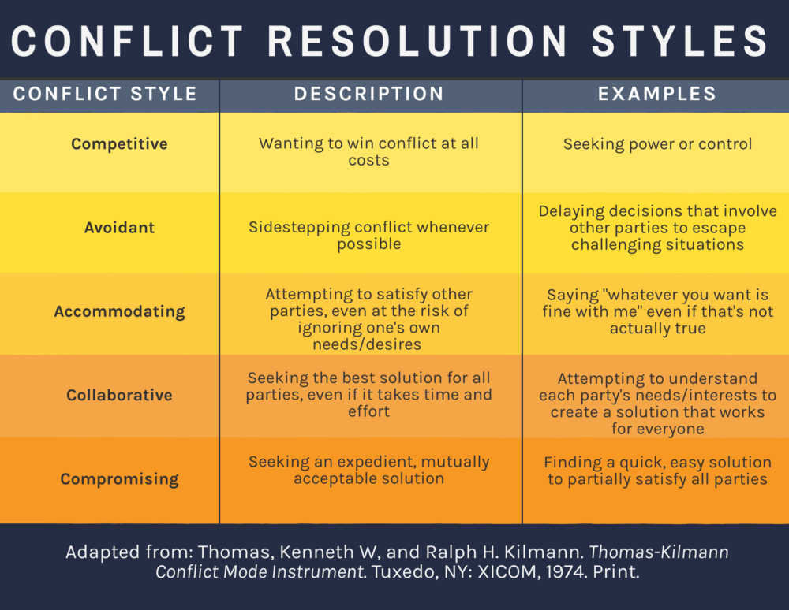

THE BLUEPRINT

Slide 8
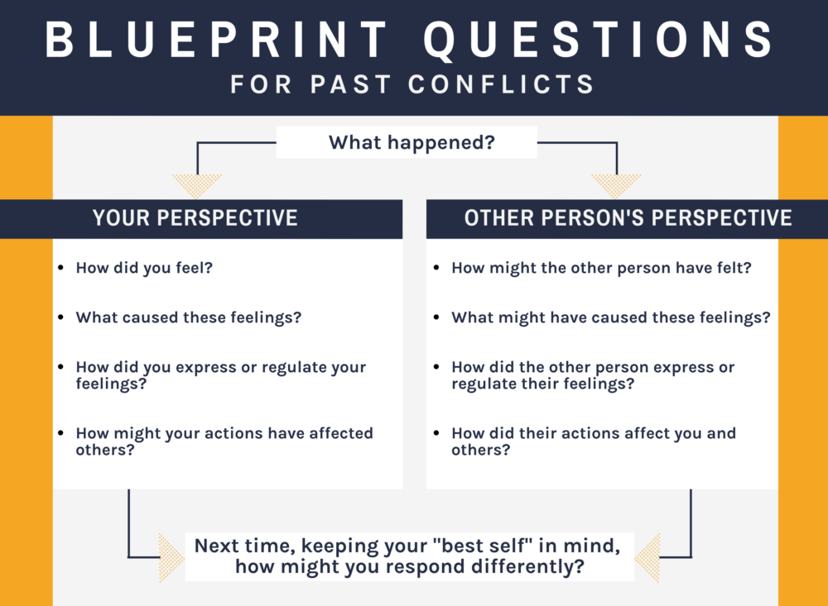
THE BLUEPRINT

Slide 9
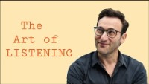
THE ART OF ACTIVE LISTENING
https://youtu.be/qpnNsSyDw-g

Slide 10
CONFLICT DE-ESCALATION
Empathy | Putting yourself in someone else’s shoes and experiencing the same feelings as that person. When we are empathic toward others, we try to see things from their perspective.
Conflict De-Escalation Strategies
Remain calm | Respect personal space
Ask the person to share what they are feeling | Empathize with the other person
Give the person choices instead of telling them what to do | Restate/clarify what the person says
Ask about facts instead of emotions | Give the person your full attention
Remember that silence in the conversation is okay | Thank the person for their positivity after the conflict is over

Slide 11
CONFLICT DE-ESCALATION
Remain calm by using a low, “Green” tone of voice and not speaking over/arguing
Respect personal space – don’t get too close or try to grab something from the person
Ask the person to share the facts and what they are feeling by using open-ended questions. Say, “How can I help you?” or “Tell me what happened” instead of
“Why are you so angry?”
Empathize with the other person’s feelings (not necessarily the behavior). Say, “You have every right to feel frustrated about that.” Avoid addressing the behavior or yelling.
Give the person choices instead of telling them what to do. Instead of forcing an agitated person right into a discussion, try offering a temporary break “Why don’t we take a minute before we continue this conversation?”
Restate/clarify what the person says. Respond selectively, and don’t assume that you know what the person means. Show real interest in what the person has to say.
Give the person your full attention, including body language.
Remember that silence in the conversation is okay – it allows the individual time to figure out responses and to plan how to say what they need to say.
Thank the person for their positivity after the conflict is over

Slide 12
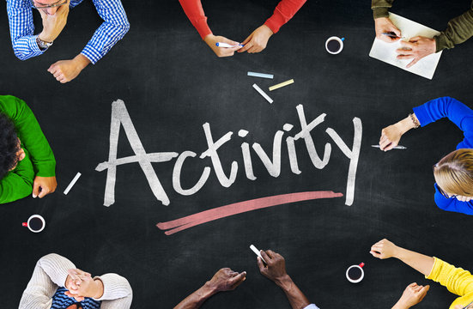
USING THE BLUEPRINT
REFLECT on one of the following scenarios in your life:
A recent, challenging situation with a colleague, student, or parent that was not handled well
A current dilemma with a colleague, student, or parent that was not handled well
An upcoming challenging meeting or encounter they anticipate will be difficult
NOTE: If you share your Blueprint with a partner, be mindful about
(a) who you choose to Blueprint about, and (b) what details to keep confidential.

Slide 13
THE BLUEPRINT

Slide 14

ARE YOU FEELING IT?
...Thank you!

